Slide 1
Neighborhood data and indicators
June 8, 2020

Slide 2
Changes over time
Really important for all sorts of urban planning questions!
Did more people in Fruitvale take transit after putting in new transit-oriented development?
Have crimes in Richmond gone down around Pogo Park after the new lighting was installed?
Are house values going up more quickly in the Mission than in the rest of San Francisco?
Is the percent of children in Chinatown increasing or decreasing?

Slide 3
Some general rules
In general, do not compare ACS time periods that overlap!
E.g., don’t compare county level data from 2011 1-year ACS to 2015 5-year ACS
Don’t compare 2011-15 ACS to 2014-2018 ACS
When you are comparing your community to a larger geography (e.g. county), use the same ACS 5-year dataset, even if you can get a single year estimate for the larger geography
In other words, when comparing across places at different scales, use the ACS dataset they have in common

Slide 4
Changing Variable definitions
Tables, and also the definitions of the underlying data, change; there is no easy fix or rule
True for Census/ACS, but also all other datasets
Metadata
Is the universe the same?
Are the variables the same?
If you’re comparing ACS 2017 5-year estimates to 2000 SF3 (long form) Census data
Census table compatibility website
Note that it is going to give you very conservative answers
Notes:
B23025
B23004

Slide 5
Indicators
Indicators: Second-hand, multi-dimensional and/or normalized measurements
Neighborhood of residence as an indicator of status
School test scores as an indicator of neighborhood quality
Unemployment rate as an indicator of people looking for work
GDP as a measure of nation’s economic health

Slide 6
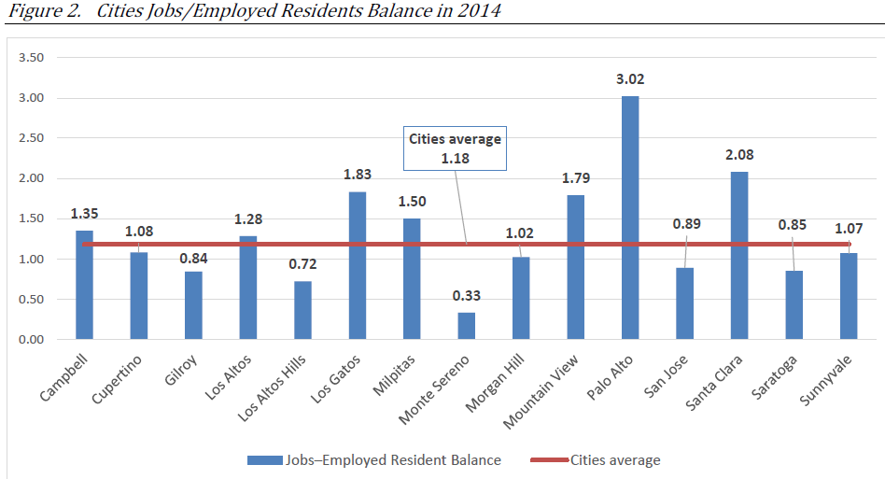
INDICATOR Example: jobs/housing balance
Potential source: LEHD

Slide 7
COMPouND Indicators
Gentrification (process of neighborhood change characterized by new real estate investment and an influx of new residents with different demographic characteristics):
Urban Displacement Project definition
For vulnerable neighborhoods
Change in income (relative to regional median)
Change in educational attainment (relative to regional median)
Housing price appreciation and rent increases (relative to reg’l median)
Other possibilities?
Change in race/ethnicity
Change in household type
Change in tenure (renter→owner-occupied)
Year resident moved in
Age of housing stock

Slide 8
A question!
Sean Adibi – Singleton Chapter 5 The authors argue that formalizing the broad array of urban experiences into succinct variables ensure effective and equitable policymaking. For one, the United Kingdom defines six ‘indices of deprivation’ that inform urban planning initiatives: (1) employment, (2) education, skills, and training, (3) health and disability, (4) crime, (5) barriers to housing and services, and (6) living environment. Has the United States identified a succinct set of indices in order to adequately quantify variegated neighborhood effects between metropolitan areas? How might the implementation of the United Kingdom’s indices of deprivation in the United States promote equity and justice for low-income, urban communities? How might the standardization of variables inadvertently oversimplify and, in turn, obscure specific neighborhood effects that vary on a city-by-city basis?

Slide 9
IS WEST BERKELEY GENTRIFIED?

Slide 10
Indices
Scaled or normalized indicator
Density (population standardized by square mile)
Per capita income (aggregate income/population)
Household income as % of area median income (for housing programs)
Poverty line
Favorable ranking (often on Likert scale)
Location quotients

Slide 11
Location Quotients
measure that compares composition between two places, one of which is a subset of the other
Composition Places
Race tract vs. city
Age (used as a category) city vs. county
Housing Stock school district vs. state
Occupation metro area vs. nation
Employment by sector nation vs. world

Slide 12
Comparison geographies
What’s the right comparison?
Often depends on the question, context of local geography, and goal of the research
Different possible scales
Neighborhood (tract or multiple tracts) → County
Neighborhood (tract or multiple tracts) → City
County → MSA (or region)
County → State
State → USA
We usually compare a smaller geography to the totality of the larger scale geography
E.g., if you’re looking at Fruitvale, the comparison is Alameda county, not Alameda County minus Fruitvale tracts
However, bear in mind that the larger geography includes your case study data, which could be important if the case study area is a sizable share of the larger geography

Slide 13
Location Quotients
# in category in subarea/total # in subarea
# in category in reference place/total # in reference place
(a ratio of two ratios)

Slide 14
Location Quotients
# Hispanic in tract/total population in tract
# Hispanic in Oakland/total # in Oakland
If LQ > 1: tract is over-represented relative to city
If LQ < 1: tract is under-represented relative to city

Slide 15
Location Quotients
# Hispanic in tract/total population in tract
# Hispanic in Oakland/total # in Oakland
200/4000 = 0.05 = 0.22 (underrepresented)
87,467/399,484 0.23
2000/4000 = 0.50 = 2.17 (overrepresented)
87,467/399,484 0.23

Slide 16
Underutilized metrics in census
Mobility (Tenure by Year Householder Moved into Unit) (B25038)
Vacancy Status (B25004)
Includes how many are owned but not lived in, as well as how many are “seasonal” or “recreational”
Over time, could be an indicator of increase AirBnB, “investor” condos
Loss of naturally occurring affordable housing
Simplest way: look at change in rental unit cost mix over time – has your tract lost units that rent at less than $800 per month?

